Slide 2
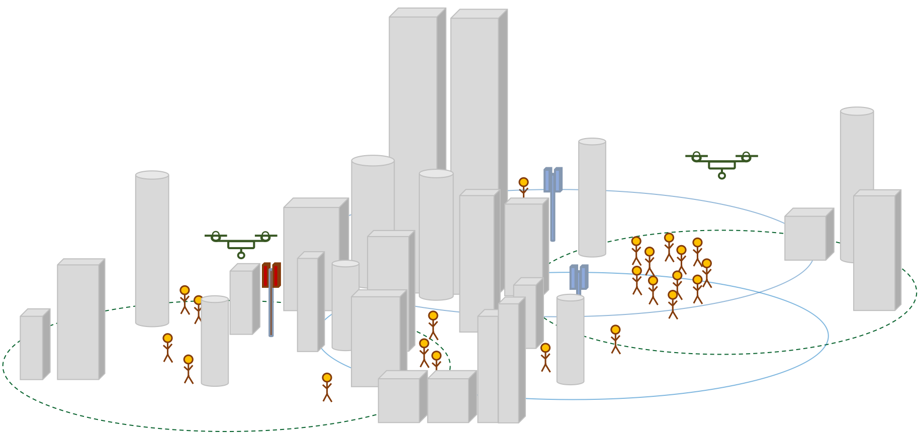
Environment
Airborne-BSs (Agents)
Reinforcement Learning Algorithm
SARSA or Deep Q Network
……
Observation
Control
……
Mobile Stations
Airborne-BSs
Building Position
Connection Condition
Environment information send to

Slide 3
Layer 1: 2-dimensional Gaussian distributions
Layer 2: 2-dimensional Gaussian distributions
Layer 3: 2-dimensional Gaussian distributions
Layer 4: 2-dimensional Uniform distributions
……

